Slide 1

Death Is Not the End: A Longitudinal Study on the Impact of Automatic Updates on Container Vulnerability Lifespans
Simge Tekin¹, Octavian Suciu², Sungsu Kwag¹, Yonghwi Kwon¹, Tudor Dumitras¹
University of Maryland, College Park¹
Google Research²

Slide 2

Automatic Patching
Faster remediation and shorter exposure windows
Reduces manual effort

Slide 3



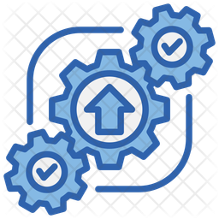
Automatic Patching in Containers
Vuln. disappears across the supply-chain
Fix once upstream
Rebuild downstream
App 1
Build and Test
App 1
Trigger
App 2
App 2
App 3
App 3

Slide 4
Automatic Patching Mechanism in Containers
debian
bullseye-slim
debian:
bullseye-slim
debian
bullseye-slim
debian:bullseye-slim
openjdk
8-jdk-slim
openjdk
8-jdk-slim
Tag: mutable string identifier
openjdk:8-jdk-slim
orientdb
2.2.37
orientdb:2.2.37

Slide 5
Automatic Patching Mechanism in Containers
debian
bullseye-slim
debian:
bullseye-slim
debian
bullseye-slim
debian:bullseye-slim
openjdk
8-jdk-slim
openjdk
8-jdk-slim
Tag: mutable string identifier
openjdk:8-jdk-slim
orientdb
2.2.37
orientdb:2.2.37

Slide 6


Automatic Patching Mechanism in Containers
debian
bullseye-slim
debian:
bullseye-slim
debian
bullseye-slim
debian:bullseye-slim
openjdk
8-jdk-slim
openjdk
8-jdk-slim
Tag: mutable string identifier
openjdk:8-jdk-slim
orientdb
2.2.37
orientdb:2.2.37

Slide 7

Automatic Patching in Containers
Automated patching creates a false sense of security
78% of inherited vulnerabilities remain unresolved after the CISA-recommended 30-day window

Slide 8

Illustration – CVE-2021-46828
High severity DoS vulnerability in libtirpc lived in orientdb image for 57 days after disclosure
24 days more after the source is patched
debian
bullseye-slim
debian:
bullseye-slim
debian
bullseye-slim
openjdk
8-jdk-slim
openjdk
8-jdk-slim
orientdb
2.2.37

Slide 9
Illustration – CVE-2021-46828
High severity DoS vulnerability in libtirpc lived in orientdb image for 57 days after disclosure
No patch flow for 44 days
debian
bullseye-slim
debian:
bullseye-slim
debian
bullseye-slim
openjdk
8-jdk-slim
openjdk
8-jdk-slim
End-of-life
orientdb
2.2.37

Slide 10

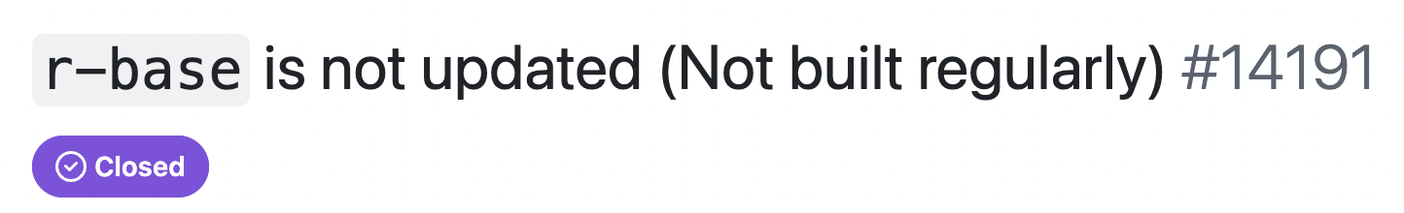
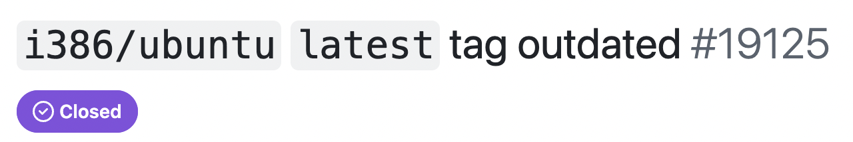

Qualitative Study on Automatic Patching
54 GitHub issues from 4 popular Docker Official Images application repositories:
Unclear end-of-life
Over-reliance on automation
Fragmented responsibilities
“Why has this tag not been updated for months?”
User
“It is no longer maintained”
Container Developer

Slide 11
Qualitative Study on Automatic Patching
54 GitHub issues from 4 popular Docker Official Images application repositories:
Unclear end-of-life
Over-reliance on automation
Fragmented responsibilities
“Why has this tag not been updated for months?”
User
“It is no longer maintained”
Container Developer

Slide 12
Research Question
How long do vulnerabilities actually live in container images and what factors influence these durations?

Slide 13
Prior Work
Vulnerability Prevalence & Inheritance
Base images are a major source of vulnerabilities in containers [1][2]
Technical Lag and Lifespan:
The gap between the versions of packages in a container and the most recent versions [3]
Manual analysis of vuln. lifespan across different tags [4]
[1] R. Shu et al. “A study of security vulnerabilities on docker hub,” Conference on Data and Application Security and Privacy, 2017.
[2] A. Zerouali et al. “On the relation between outdated docker containers, severity vulnerabilities, and bugs,” SANER, 2019.
[3] M. U. Haque et al. “Well begun is half done: An empirical study of exploitability & impact of base-image vulnerabilities,”SANER, 2022.
[4] P. Liu et al. “Understanding the security risks of docker hub,” ESORICS, 2020

Slide 14
Methods – Lineage Model
Lineage = Longitudinal view of tags
Tag (e.g., orientdb:2.2.37) ≈ Git branch
Image ≈ commit
Lifespan after disclosure
orientdb:2.2.37
CVE-2021-46828
First vulnerable image
Disclosure date
First non-vulnerable image
Full lifespan

Slide 15
Methods– Multistate Survival Analysis
Estimates the probability of an event by a specified time while accounting for competing events
Birth
Death

Slide 16
Methods– Multistate Survival Analysis
Estimates the probability of an event by a specified time while accounting for competing events
Lineage EOL
Birth
Fix

Slide 17
Methods– Multistate Survival Analysis
Estimates the probability of an event by a specified time while accounting for competing events
Base Lineage EOL
Lineage EOL
Birth
Implicit Fix
Explicit Fix
Overwrite

Slide 18





Dataset
9,156
CVEs Analyzed
137
Applications
756,313
Docker Images
6.5+ Years
Longitudinal Study
Official Docker Images:
Regularly updated base images
Derived images rebuilt automatically

Slide 19
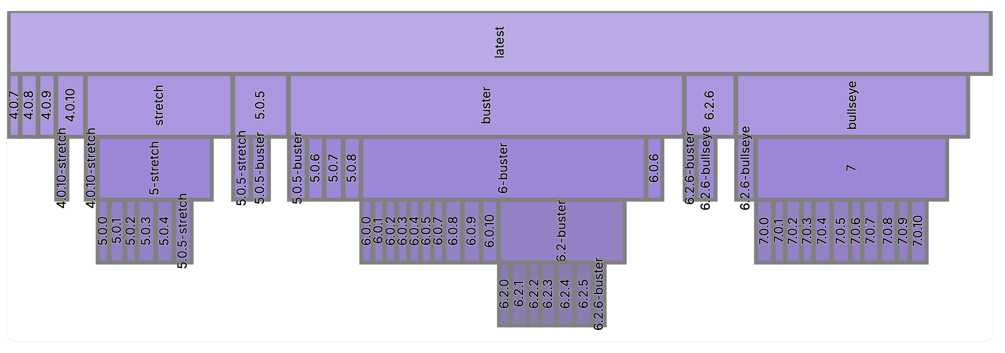
EOL is Much More Frequent
Redis tags
Generic
Tags
Specific
Tags
Traditional software: Fewer product lines, clearly announced EOL

Slide 20
EOL is Much More Frequent
Redis tags
Generic
Tags
Specific
Tags
Traditional software: Fewer product lines, clearly announced EOL

Slide 21
EOL Breaks Patch Propagation
11% survive indefinitely due to EOL
303 more days after EOL on average (median:168)
debian
bullseye-slim
debian:bullseye-slim
Longitudinal View
openjdk
8-jdk-slim
openjdk:8-jdk-slim
No patch flow
orientdb
2.2.37
orientdb:2.2.37

Slide 22
Layered EOL Causes Hidden Patch Failures
Up to 23% of vulnerabilities survive indefinitely at deeper dependency layers
debian:bullseye-slim
openjdk:8-jdk-slim
No patch flow
EOL
orientdb:2.2.37
Active

Slide 23
Layered EOL Causes Hidden Patch Failures
Up to 23% of vulnerabilities survive indefinitely at deeper dependency layers
debian:bullseye-slim
openjdk:8-jdk-slim
No patch flow
EOL
orientdb:2.2.37
Active
orientdb:2.2.37-spatial
Active

Slide 24
Layered EOL Causes Hidden Patch Failures
Up to 23% of vulnerabilities survive indefinitely at deeper dependency layers
debian:bullseye-slim
openjdk:8-jdk-slim
No patch flow
EOL
orientdb:2.2.37
Active
orientdb:2.2.37-spatial
Active

Slide 25
More Findings and Insights
Use of a more ‘specific’ tag can decrease the patch rate by up to 35%
Manual intervention is rare:
4.5% fixed via base image update
3.5% fixed by the derived image locally by overwriting, while the source base image is vulnerable

Slide 26
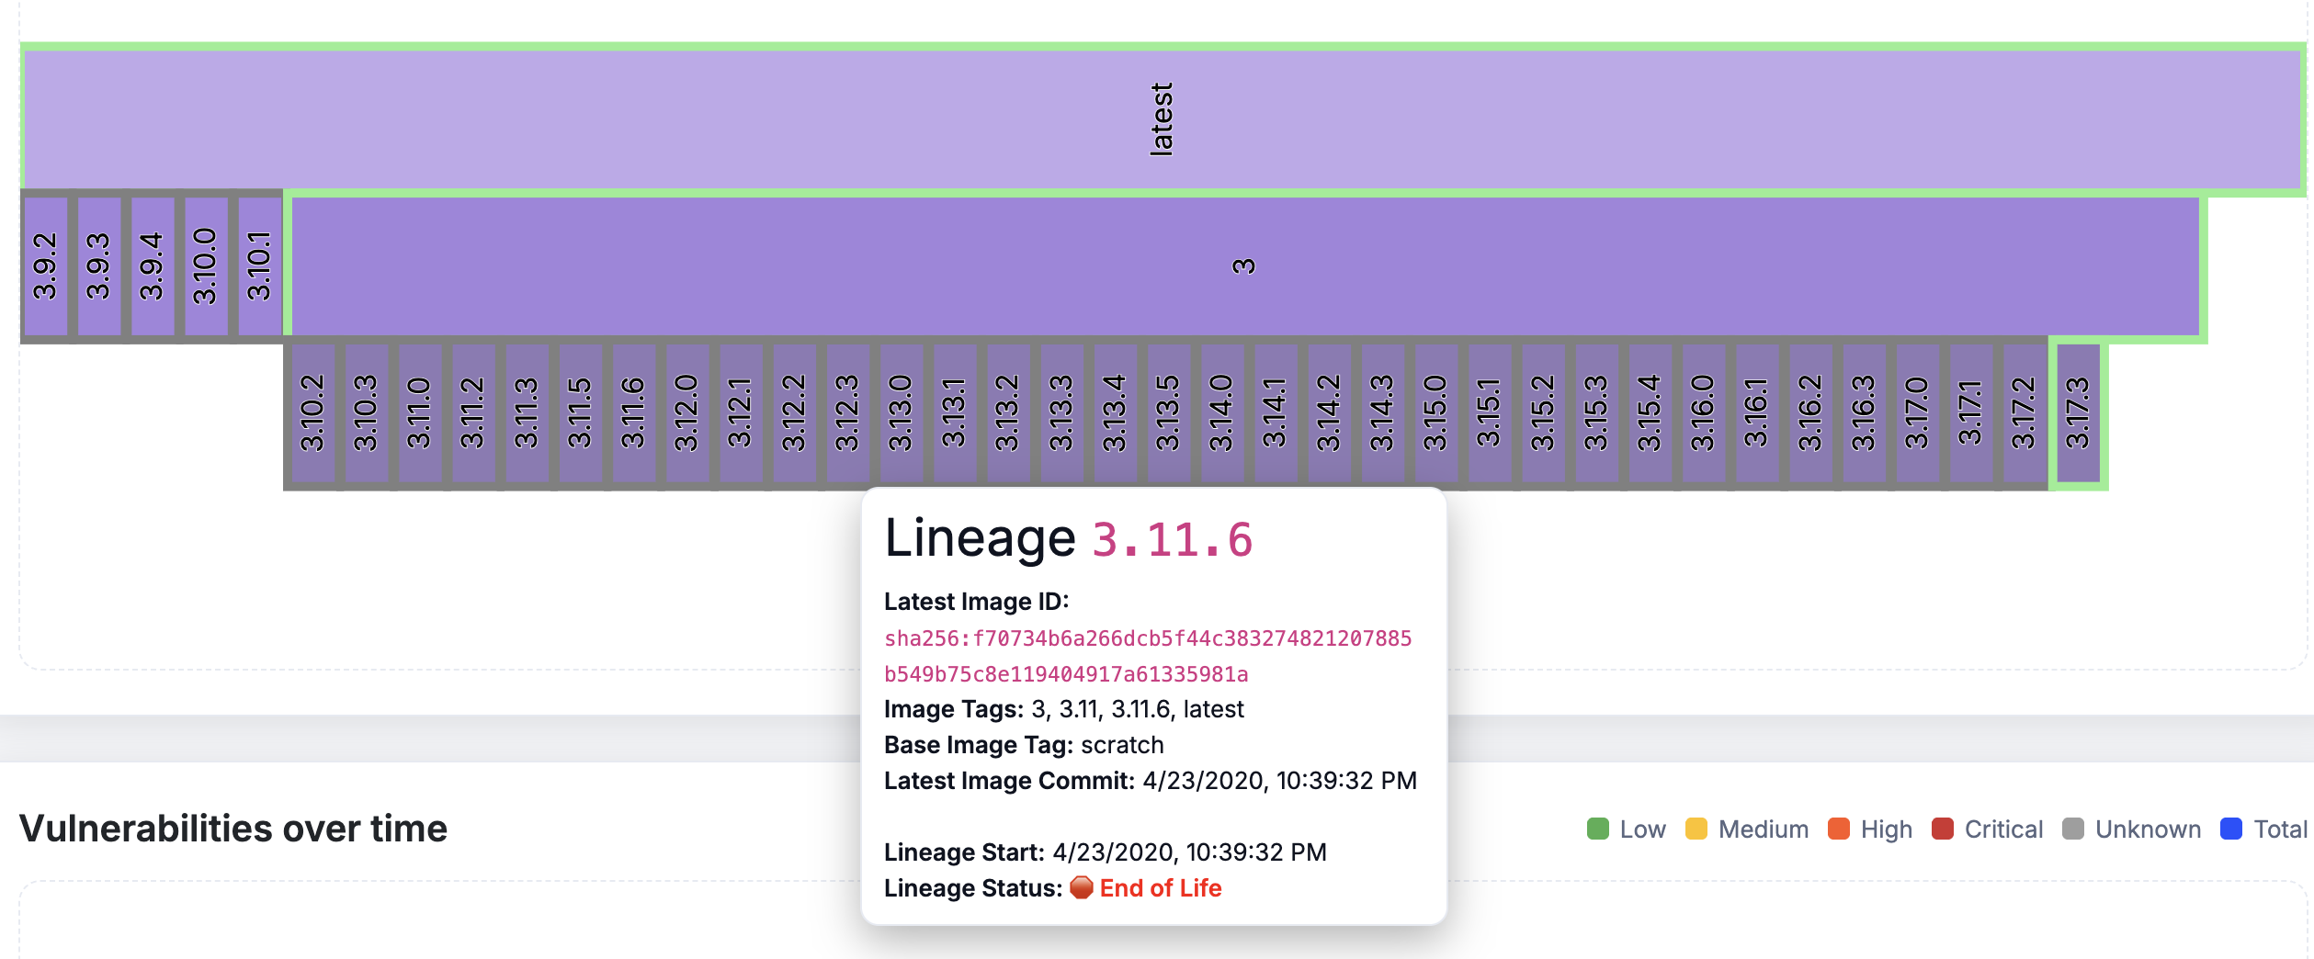


Actionable Takeaways
Integrate EOL tracking into CI/CD
Choose base images based on lineage structure
Utilize targeted overwrites when base image falls short in patching
Notes:
Right now, the only thing that the developers can use to determine the specificity of a tag is the tag string itself. However, the tagging conventions are not consistent across applications and sometimes even within the same app. Lineages also recover the hierarchical relationship between the tags. Our tool also visualizes this hierarchy.
Third, patch propagation is broken or too slow, developers can patch the inherited vulnerabilities with targeted overwrites.

Slide 27
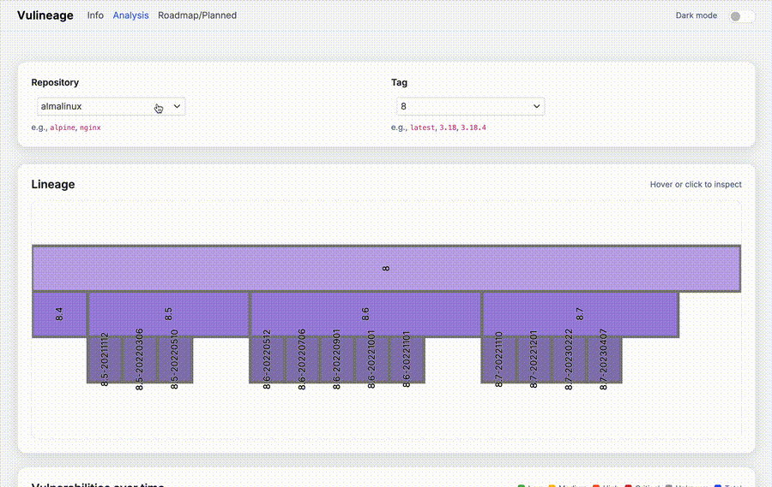

Thank you!
Simge Tekin
stekin@umd.edu
Scan Me
tool.vulineage.com

Slide 28
Tag Generality Affects Patch Propagation
Use of a more ‘specific’ tag can decrease the patch rate by up to 35%
Generic
Tags
More Specific
Tags

